Slide 1
3 eras, 3 metaphors, 3 models
Era of abundance (before 1973)
infinite frontier
cowboy economy
Era of energy constraints (1973-2008)
severe economic havoc wrought by OPEC oil embargo
Age of resource depletion (2008 on)
spaceship earth

Slide 2

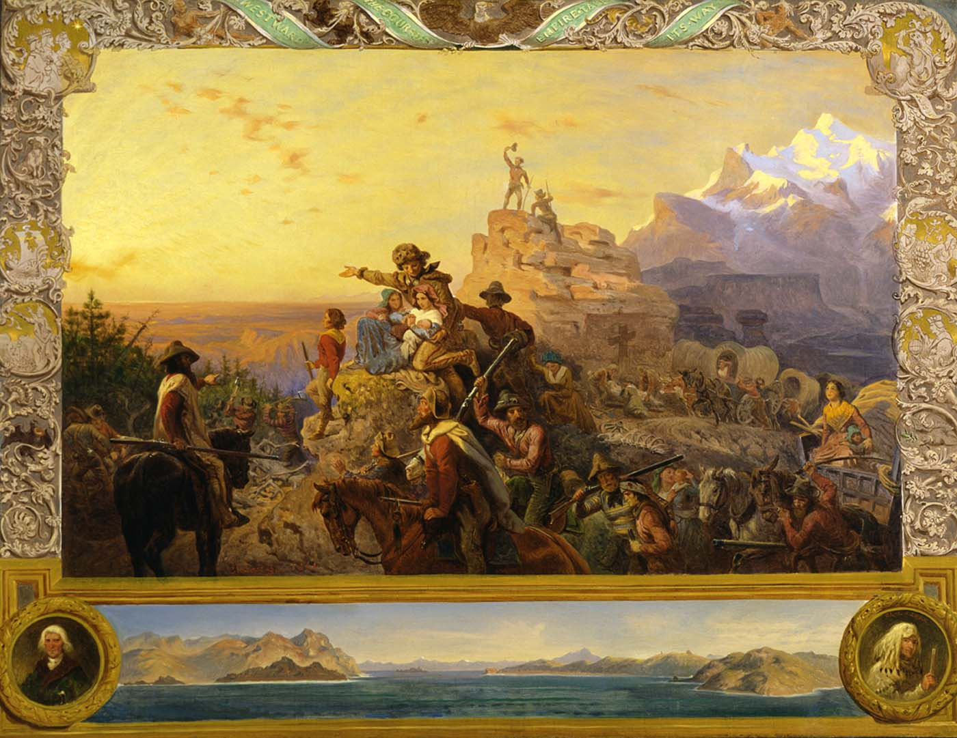
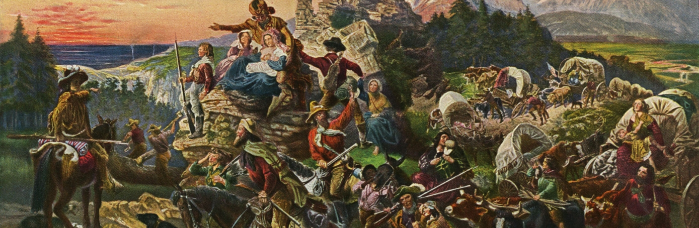


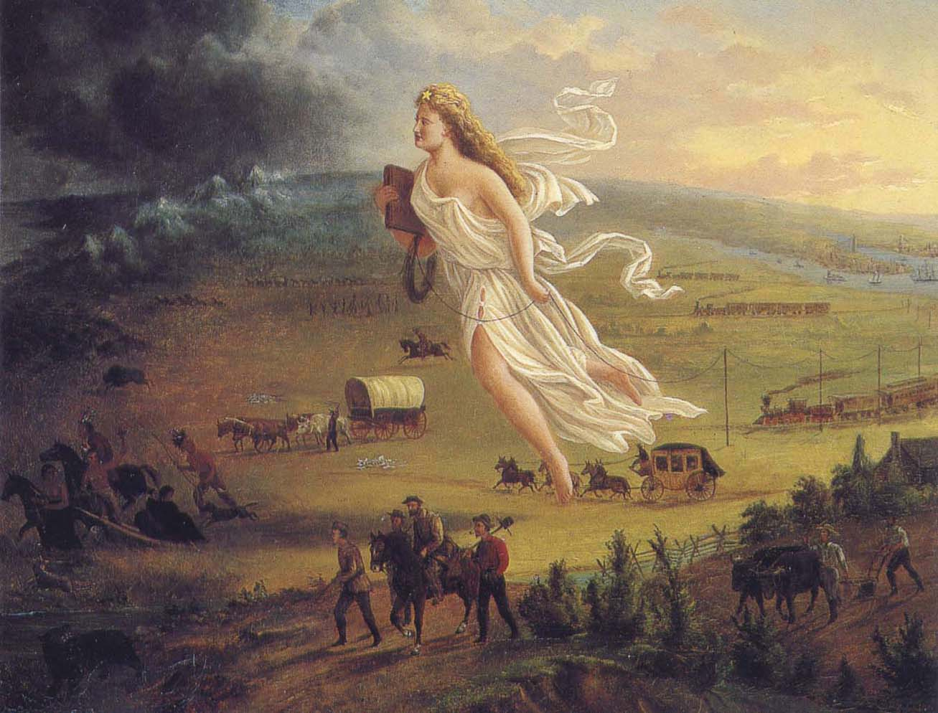
Era of abundance
ue

Slide 3
Era of abundance
Circular economy
Households:
exchange labor and capital for income
purchase goods and services from producers
Perpetual motion of 1st kind

